Slide 1



DELIVER
Projects and Programme Management

Slide 2
Projects and Programme Management
 | Pre-workshop study | Programme Objectives
 | Introduction to projects and programme management | To get a basic understanding of programmes and projects and its importance
 | Importance of good governance | To appreciate why good governance is essential in MSPs (Managing successful Programmes)
 | Stakeholder management fundamentals and tools | To gain an understanding of stakeholders and how to manage them
 |  | To learn new tools on stakeholder management
 | Lean projects | To learn the basics of lean projects using lean management tools and principles
Notes:
Need to check review these.

Slide 3

Introduction to Project Management
Watch these 2 short videos on Introduction to Project Management
https://www.youtube.com/watch?v=BOU1YP5NZVA
https://www.youtube.com/watch?v=9LSnINglkQA

Slide 4
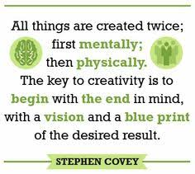
PROJECT MANAGEMENT
Notes:
Need to check review these.

Slide 5
What is A Programme and A Project?
“A programme is a temporary, flexible organisation created to coordinate, direct and oversee the implementation of a set of related projects and activities in order to deliver outcomes and benefits related to the organisation’s strategic objectives.”
“A project is a temporary organisation, usually existing for a much shorter duration, which will deliver one or more outputs in accordance with a specific business case.”
Programme deals with outcomes
Projects deals with outputs
Notes:
Need to check review these.

Slide 6
Projects versus Programmes
PROJECTS
PROGRAMMES
Driven by vision of end state
No pre-defined path
Changes to the business capability
Coordinated delivery of outputs
Benefits realised during the programme and afterwards
Longer timescale
Driven by deliverables
Finite -definite start and finish
Delivery of products
Benefits usually realised after project closure
Shorter timescale
Notes:
Need to check review these.

Slide 7
What is project management?
Project management is the application of processes, methods, skills and experience to achieve the project objectives.
It is the process of planning, organising and managing tasks and resources.
Successful PM is about structure, control, sufficient attention to detail and continuously driving action.

Slide 8

Why do we need project management?
Because we live in a world of limited resources and not enough time
There will always be more to do than time and resources will allow.
Project management tools and techniques, if used appropriately, help us make more effective use of time.

Slide 9

Programmes and Projects
Can you think of examples of programmes and projects that are being delivered or have been delivered in the LGU?
Remember a programme can be an umbrella of multiple related projects contributing to the same outcomes.

Slide 10
The Project Management Process
1.Initiating
5. Closing
2.Planning
4.Monitoring and control
3.Delivery
Watch the 2 minute video on Project Lifecycle. The project life cycle will be discussed further at the face to face workshops.

Slide 11
1.0 Project Initiation
The purpose of the Project Initiation Documentation is to define the project, in order to form the basis for its management and an assessment of its overall success. The Project Initiation Documentation gives the direction and scope of the project. It is an essential document for any project because:
It ensures that the project has a sound basis.
It acts as a base document against which the Project Board and Project Manager can assess progress, issues and ongoing viability questions
It facilitates a critical-thinking process around key project parameters
It provides a single source of reference about the project so that any interested stakeholder could quickly and easily find out what the project is about, and how it is being managed

Slide 12
Project Initiation defining the ‘why’ and the ‘what’
Questions to answer at this stage
What is the project going to do? | Project definition – confirm objectives, scope, benefits and risks. Initial effort, costs and duration
What is the business case?
How will the project be funded?
Who wants it to happen? | Project governance and organisation – project sponsor, manager and team. Define roles and accountabilities.
Who will manage the project?
Who will perform the work?
Notes:
Success in projects depends on understanding precisely, completely, and unambiguously what you are trying to achieve.

Slide 13
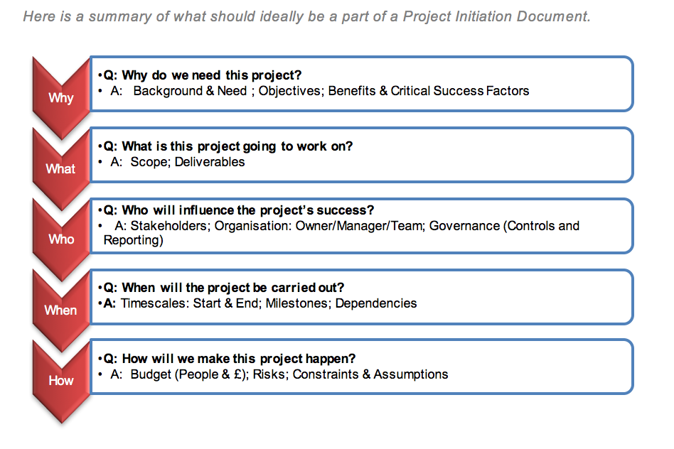

Slide 14

Defining Stakeholders
At the initiation phase it is crucial to define and agree the stakeholders.
“A stakeholder is any individual, group, or organisation that can affect , be affected by, or perceive itself to be affected by a programme.”

Slide 15
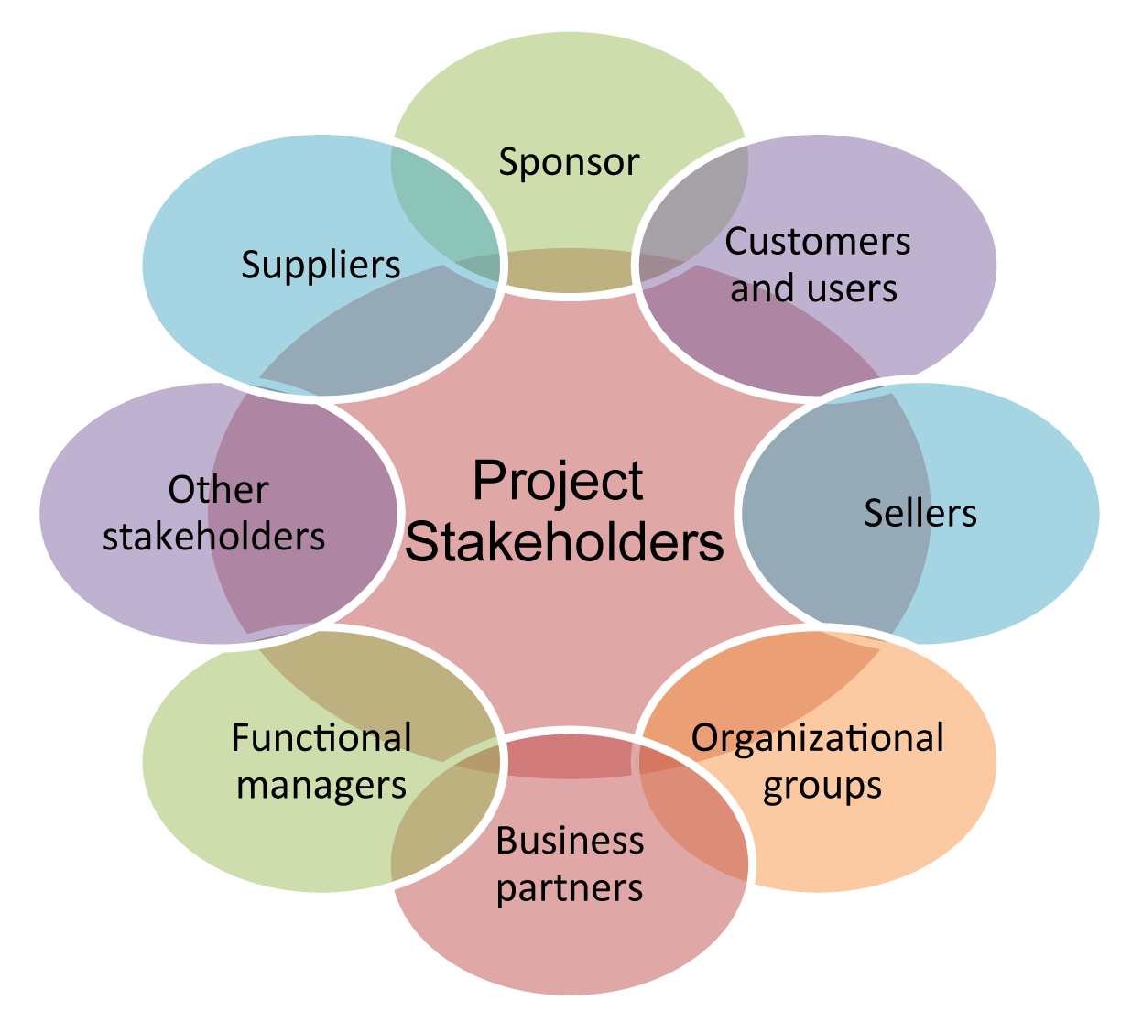
Stakeholder Wheel

Slide 16
Stakeholder Management Power (to influence project)
High
Can change the direction of the project
Tend to be directors or senior management level of affected area
Some
Has some influence
Would be listened to (possess specialist knowledge)
Low
Have (or feel they have) little or no ability to influence the project
End users typical
Make project decisions
Tend to be lower level managers , senior managers of non affected areas or supervisory level
Have the ear of those making decisions

Slide 17
Stakeholder Management Interest
High
Directly affected or impacted by the project
Is of a major concern
Some
Indirectly affected or impacted by the project
Not sole concern, more pressing or many other concerns
Low
Not affected by the project
Employees on a related area
Employees of affected area
Users

Slide 18
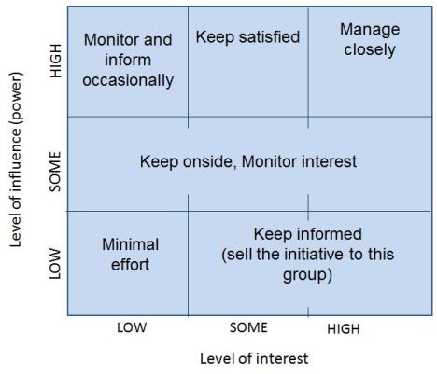
Managing Stakeholders Power/Interest Grid

Slide 19

Level of Power & Interest
Power | Power Interest Grid
 | High | Watch | Keep Satisfied | Constant Active Management
 | Some | Keep on side
 | Low | Ignore | Keep Informed
 |  | Low | Some | High
 | Interest
Notes:
Print out worksheet

Slide 20


Tasks
Read the stakeholder analysis summary sheet.
2. Do the bitesize training on Stakeholder Management.

Slide 21

Project and Programme Governance
Read Article on
Project and Program Governance
Using Senior Management Support to Ensure Project Success
Notes:
Need to check review these.

Slide 22
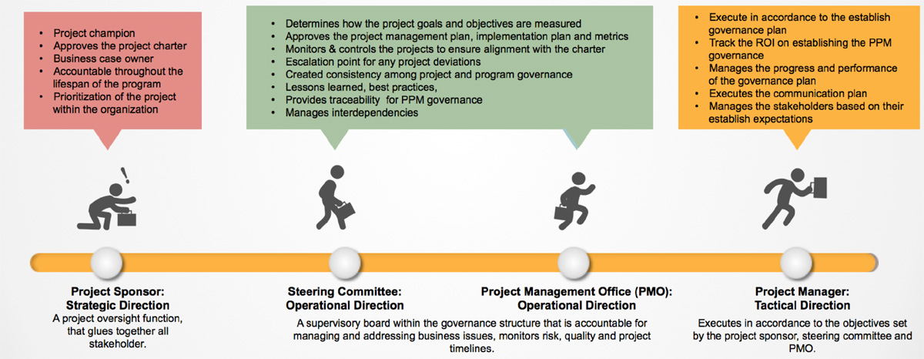
Project Governance

Slide 23

Who is responsible for what?
Project Sponsor ‘person who is paying for it’
Stakeholders ‘those affected by it, and with an interest in it’
Project champion ‘person who wants to see it happen’
Project team
‘people who make it happen’
Project manager
‘person who will ensure it happens’

Slide 24
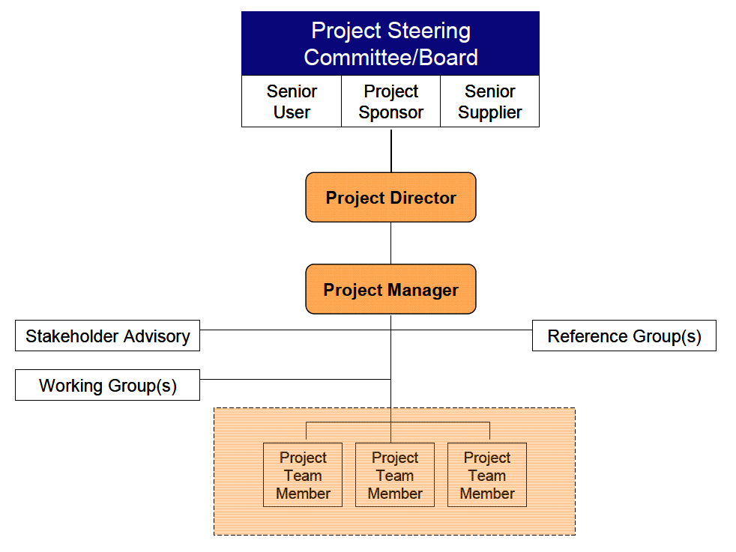
Sample structure

Slide 25
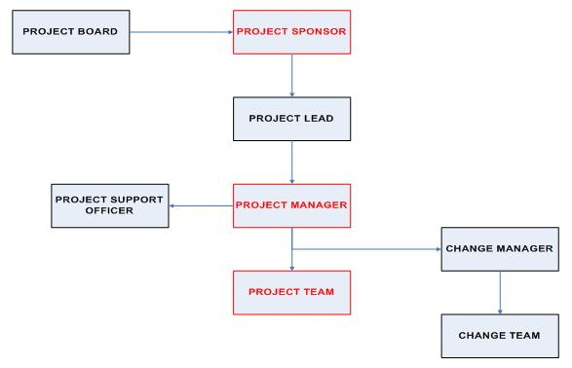
Sample structure

Slide 26


Slide 27
2.0 Project Planning – the ‘how’
At simplest level this is a list of tasks you need to complete to meet objective. The Plan shows the order of tasks, length of time and who is responsible.
Needs to include how you will manage any risks and communication plans.
If this stage is not performed well, it is unlikely that the project will be successful.

Slide 28


Slide 29

The importance of planning
The temptation is to get started. It gives the appearance of immediate activity and progress.
But this leads to mistakes and waste.
We end up with Plan-Do, Do-Re-Do, Re-Plan, Re-Do, Re-Plan, Re-Do!

Slide 30
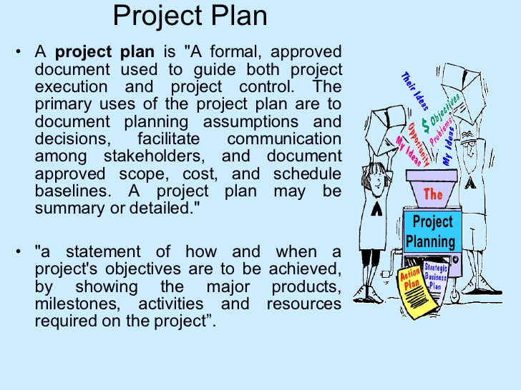

Slide 31

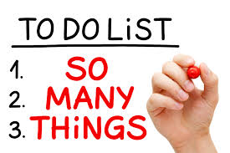
But I’m too busy to do any planning
Planning allow you to:
Ensure people are working on activities that are needed and do them correctly the first time, not waste time doing unnecessary activities
Anticipate potential problems and take preventative action (see risk mgmt.)
Do things in the right order at the right time

Slide 32

Project Planning
Watch the video – How to create a project plan based on reality
https://www.youtube.com/watch?v=d7kRyjm6xv8

Slide 33

4.0 Project Delivery
Project execution’s key purpose is to complete the work defined in the project management plan and to meet key project objectives. During this phase a project leader will focus on these key processes:
Managing people
Following processes
Communicating information to all key stakeholders, sponsors and team members

Slide 34

Task
Watch the video on how to run a project.

Slide 35
Tips in Project Execution
1. Begin with the End in Mind
2. Gain Buy-in from Your Core Team
3. Project Leaders Get Their Projects Across the Finish Line
4. Build a High Performing Team
5. Monitor Progress and Performance through Accountability
6. Listen to Lead
7. Be Open and Flexible
8. Celebrate Incremental Achievements Along the Way
9. There Is No “I” in Team
10. Champion a New Reality
Read the Article Tips in Project Execution

Slide 36
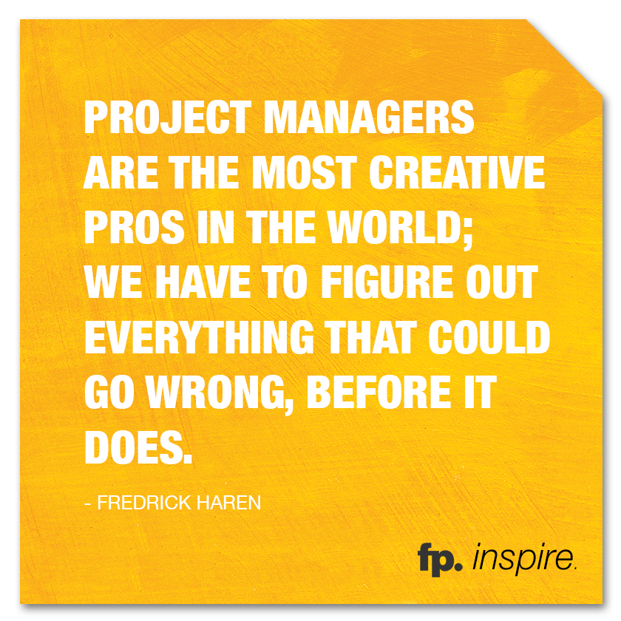

Slide 37

Communication
Make sure that you're clear about who is responsible for communicating to team members, the project board, the different stakeholders within the business, and relevant third parties. Inadequate communication is a frequent problem area for projects, and it needs considerable attention to communicate well.

Slide 38
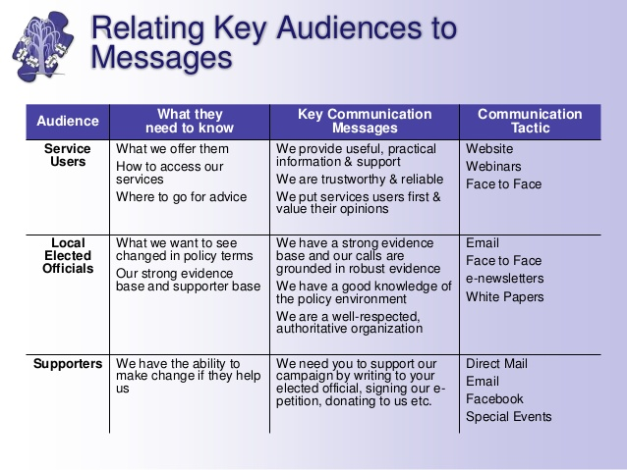

Slide 39
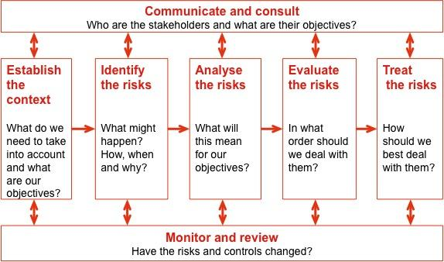

Slide 40
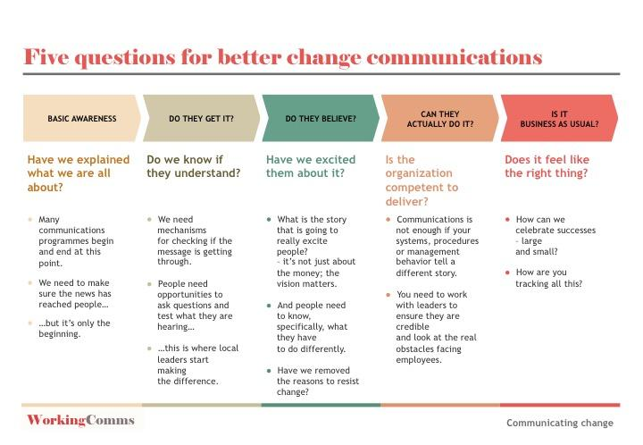

Slide 41
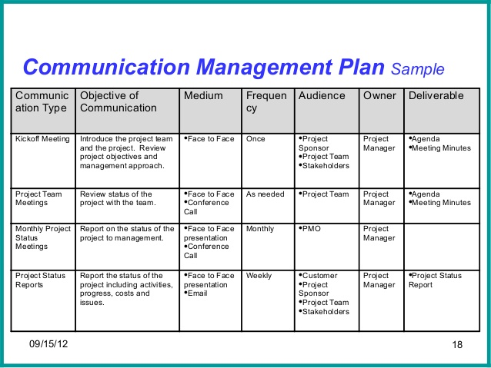
Communication plans

Slide 42
Monitoring and Control
Overall objective is to meet project deliverables in the Project Plan. This is a cyclical stage and your project will determine how long you are in this stage.
Key tasks – manage people, quality, risk and change, track and review data, review deliverables and effort, report and analyse progress
"All project managers face problems on Monday mornings - good project managers are working on next Monday’s problems"
Notes:
Day to day work of PM on the active project

Slide 43
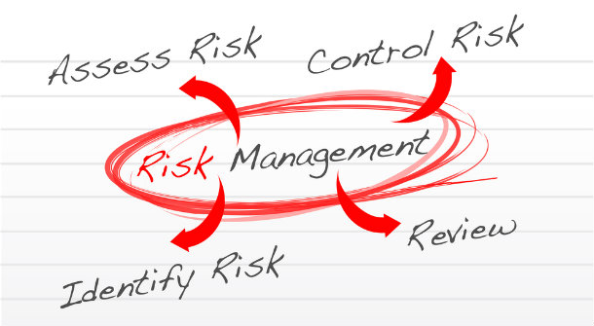
Managing risks
Notes:
Make sure that risks are identified and understood
Focus on those risks that have the greatest combination of likehood of occuring and impact on project
Control risk –
Ignore it altogether
Reduce the likelihood of it occurring
Reduce the impact if it does occur
Have contingency plans in place

Slide 44
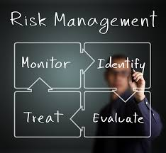

Slide 49
Communication plans

Slide 50
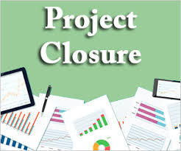
5.0 Project Closure
Closure is important for two reasons.
Tendency for projects to drift on and develop into other projects.
Important to acknowledge work of project team and record lessons learnt
Controlled closure enables you to:
Test the deliverables
Help the customer use the deliverables
Release resources

Slide 51

Project Closure
"A project is complete when it starts working for you, rather than you working for it"

Slide 52
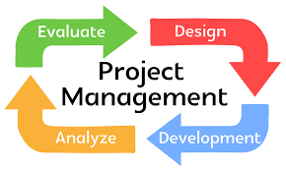
Post implementation review
Generally takes place 6-12 months after formal closure of the Project. Where the Project Closure Report looks at determining if the tasks and deliverables have been delivered the PIR looks at the project retrospectively to see if the project's anticipated benefits have been met.

Slide 53

Post implementation review
Tips to remember when conducting a post-implementation review
Ask for openness – Emphasize the importance of being open and honest in your assessment, and make sure that people aren't in any way punished for being open.
Be objective – Describe what has happened in objective terms, and then focus on improvements.
Document success – Document practices and procedures that led to project successes, and make recommendations for applying them to similar future projects.
Look with hindsight – Pay attention to the "unknowns" (now known!) that may have increased implementation risks. Develop a way of looking out for these in future projects.
Be future-focused – Remember, the purpose is to focus on the future, not to assign blame for what happened in the past. This is not the time to focus on any one person or team.
Look at both positives and negatives – Identify positive as well as negative lessons.

Slide 54
Post implementation review
Conduct a gap analysis.
Determine whether the project goals were achieved.
Determine the satisfaction of stakeholders.
Determine the project's costs and benefits.
Identify areas for further development.
Identify lessons learned.
Report findings and recommendations.

Slide 55

How to run a lean service improvement project
1.Define
What are the issues and what are the customer requirements?
2.Diagnose and analyse
Understand and analyse ‘as is’ process
3. Improve
Developing the ‘To Be’ state involves working collaboratively and creatively to define new ways of working
4. Implement
Requires staff to know, understand and implement the changes.
5. Sustain
Sustain improvements and enabled improvements to continue

Slide 56

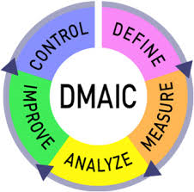
Based Problem Solving
What is the
problem?
How do we
make sure it
stays
improved
How do we
improve it?
How big is
the problem?
What is the root cause?

Slide 57
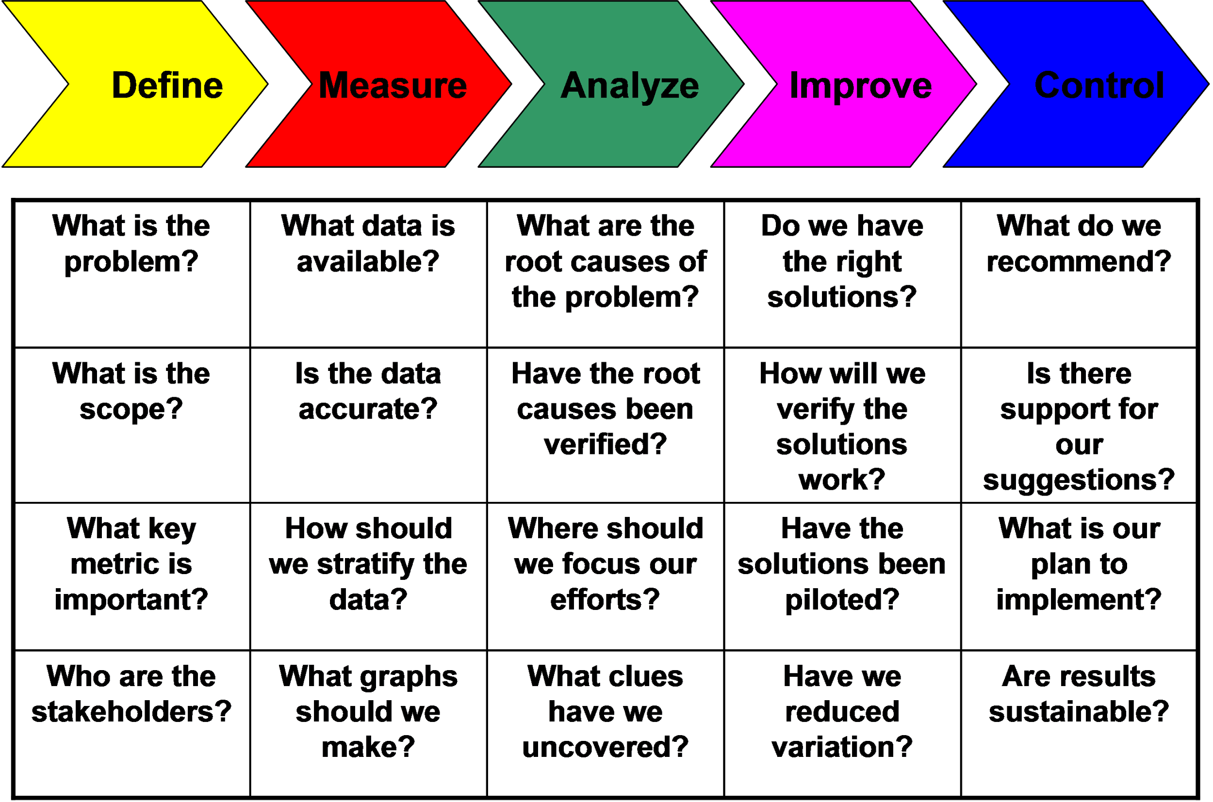

Slide 58
This will be discussed in detail at the face to face workshops.
Watch the Lean Manager video

Slide 59
THANK YOU!

